Slide 1

PINN Papers Summary
Jiwon Kang
MS-PhD Program of Mechanical Engineering
Seoul National University, South Korea

Slide 2
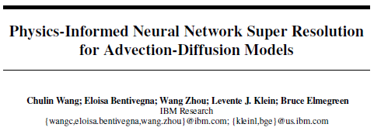
2. GOALS
1. PINN-SR
2. PINN-GAN

Slide 3
Main Idea
2. GOALS
Calculate Gas Concentration Image
1. PINN-SR
Reconstruct HR images from LR images
In an advection-diffusion model of atmospheric pollution plumes
2. PINN-GAN
PINN-SR
SR training with
Conventional pixel based constraints
Pixel based constraints
+ Governing physics law constraints
Improvements in PSNR/SSIM

Slide 4

Methodology
1. PINN-SR
Advection diffusion equation
Residual function
2. PINN-GAN
Loss Function
pixel wise loss + physics consistency loss

Slide 5
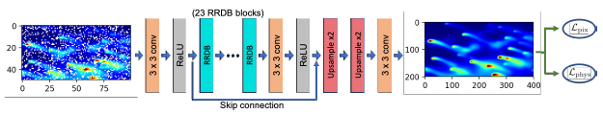
Methodology
Network Architecture of PINN-SR
1. PINN-SR
2. PINN-GAN
Use ESRGAN (2018) architecture
RRDB: The residual in residual dense block

Slide 6
Experiments
Datasets
1. PINN-SR
Calculate C(gas concentration) field
in 3 points of time t-1, t, t+1
LR, HR generated from simulation
with different spatial grid size
2. PINN-GAN
(In order to calculate the time derivative)
LR Data augmentation
with 4 dropping rates (pixel value to 0)
Stack 3 gas concentration field images as 3 channel image
(In order to mimic real satellite data)
Evaluate PINN-SR and 3 other models
with PSNR/SSIM (widely used SR criterions)
+ physics consistency loss
(how well it follow the physics rules)

Slide 7
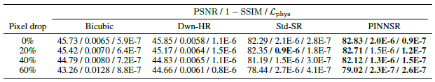
Experiments
1. PINN-SR
2. PINN-GAN
Bicubic: bicubic up-sampling to create SR (without DL model)
Dwn-HR: train with simulated HR and down-sampled HR datasets
(only HR simulated and LR interpolated from HR)
Std-SR: train with simulated LR/HR but no physics consistency loss

Slide 8
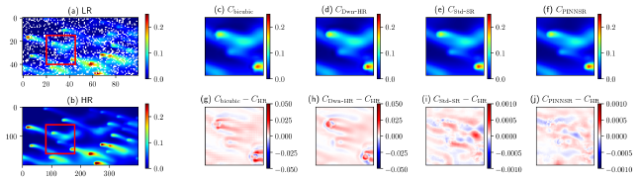
Experiments
1. PINN-SR
2. PINN-GAN
PINN-SR showing better performance in gas concentration error, PSNR, SSIM

Slide 9
Pros and Cons
Pros
1. PINN-SR
Better performance in function estimation accuracy, PSNR, SSIM
Simple and fast to train
2. PINN-GAN
Cons
Difficult to apply for different applications such as SEM image, that doesn’t have one distinct governing rule to apply

Slide 10
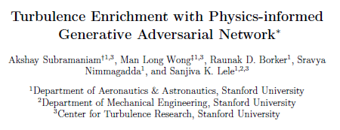
2. GOALS
1. PINN-SR
2. PINN-GAN

Slide 11
Main Idea
2. GOALS
1. PINN-SR
Estimate High resolution data(pressure, velocity) in fluid from Low resolution data
2. PINN-GAN
SR: Super resolution + GAN: Generative Adversarial Network
TEGAN(Turbulence Enrichment GAN)
Generator gets LR data input and generates fake HR data
Discriminator try to identify fake HR and real HR

Slide 12
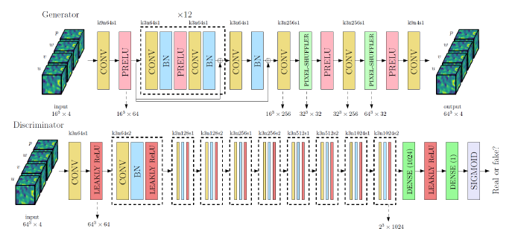
Methodology
Network Architecture
1. PINN-SR
2. PINN-GAN
Generate SR 64*64*64 data from LR 16*16*16 data

Slide 13

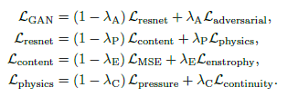
Methodology
Navier Stokes equation
Datasets
1. PINN-SR
Generated with CFD
LR, HR data from different grid size simulations
2. PINN-GAN
Loss Function
Generator: content loss + physics loss
Discriminator: logistic loss
Content loss: HR/SR MSE error
Physics loss, Enstrophy loss: residual equation loss

Slide 14
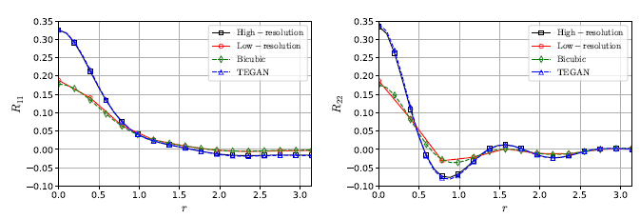
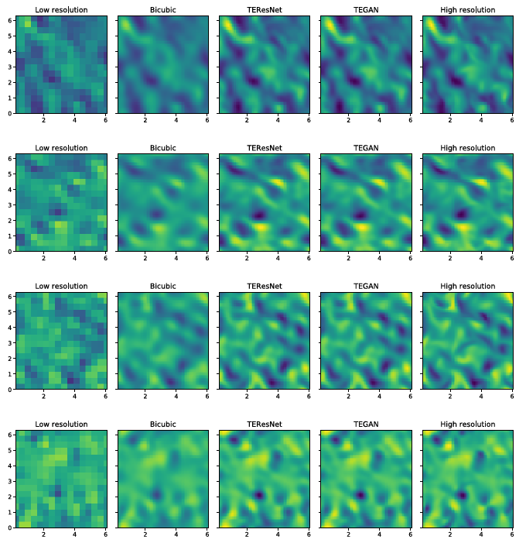
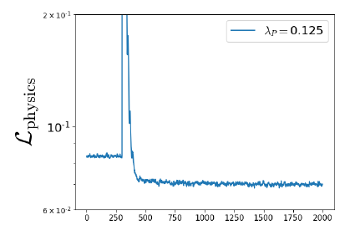
Results
1. PINN-SR
2. PINN-GAN
TEGAN results show high resemblance to HR
TEGAN show low physics loss
-> follow the physics principle well

Slide 15
Pros and Cons
Pros
1. PINN-SR
LR data can be enhanced to HR data with a single model
Outperforms previous bicubic interpolation, CNN methods
2. PINN-GAN
Cons
GAN model can be enhanced by using Wasserstein GAN (more recent model)

